Slide 1


Twitter Sentiment Analysis
Team 3

Slide 2
Introduction
Sentiment analysis is the process of using natural language
processing (NLP) tasks, along with text analysis and machine
learning techniques. The goal of this analysis is to identify
and extract the emotional tone that is expressed in the text
data, be it positive, negative, or neutral. With the rise of
social networks, such as Twitter, using sentiment analysis has
become even more valuable but also challenging. Our goal
is to apply these machine learning techniques to classify the
sentiment of tweets.

Slide 3
Problem Understanding
and Formulation
01

Slide 4
Problem Statement
Overwhelming volume of unstructured social media data makes it difficult to extract actionable insights, with traditional keyword-based sentiment tools failing to capture nuance, sarcasm, and slang in tweets.
Limited real-time understanding of public sentiment, especially during fast-evolving events (e.g., elections, brand campaigns, crises), restricts organizations from responding proactively and intelligently.
Gap in effective NLP utilization, where many solutions lack contextual awareness and rely on outdated models that struggle with short, noisy text formats like tweets.
This project aims to bridge these gaps using advanced NLP techniques, including BERT-based sentiment classification, to unlock real-time, context-aware insights from Twitter data. The approach enhances the accuracy and relevance of sentiment detection by focusing on both linguistic depth and social context.

Slide 5
Objective
Develop a machine learning model to classify sentiments expressed in tweets as positive, negative, or neutral using advanced NLP techniques.
Analyze linguistic and contextual features (e.g., sarcasm, slang, emotion) to improve sentiment classification accuracy beyond traditional methods.
Create an intuitive Streamlit-based web interface that enables real-time sentiment analysis of user-input tweets or live tweet streams.
Empower organizations, researchers, and individuals with a tool for monitoring public opinion trends, brand perception, or social event reactions through data-driven sentiment modeling.

Slide 6
The Challenge
Accurately identifying sentiment in tweets is challenging due to the informal and context-rich nature of social media language. Tweets often include slang, emojis, sarcasm, abbreviations, and incomplete sentences, making them hard for traditional models to interpret.
Sentiment is also subjective and context-dependent — the same words can convey different emotions in different situations. Additionally, tweets are restricted in length, limiting the availability of linguistic context.
The goal is not only to classify sentiment but to understand the underlying emotional tone, which can offer real-time insights into public opinion on events, brands, or societal issues.

Slide 7
The Approach
We frame this as a multi-class classification problem, aiming to categorize tweets into positive, negative, or neutral sentiments.
The approach utilizes a large, pre-labeled dataset of tweets which is cleaned, normalized, and vectorized using techniques like TF-IDF and BERT embeddings to capture both frequency and semantic meaning.
Feature engineering and NLP techniques such as tokenization, lemmatization, and stopword removal are applied to enhance text representation.
Multiple classification models were considered, with advanced methods like Support Vector Machines (SVM) and Transformer-based models (e.g., BERT) chosen for their performance in text classification tasks.

Slide 8
Proposed Solution
02

Slide 9
A lightweight web-based application that analyzes and classifies the emotional tone of tweets in real time.
Powered by state-of-the-art Natural Language Processing (NLP) models like BERT and SVM.
Designed to deliver fast and accurate sentiment insights for businesses, researchers, and social media analysts.
What is Twitter Sentiment Analyzer?
Goes beyond keyword analysis with deep contextual understanding using transformer-based models.
User-friendly interface built with Streamlit, requiring no technical expertise to operate.
Capable of processing large tweet datasets and adapting to evolving language trends.
Provides transparent, explainable results to support informed decision-making.
Easily extendable to specific domains like brand monitoring, crisis analysis, and public sentiment tracking.
Why Our Solution Stands Out?

Slide 10
Data and Features
03

Slide 11
Rich Dataset
Utilized a massive dataset of 1.6 million labeled tweets containing a diverse mix of emotional content, social commentary, and opinions across different domains and timelines.
Data Cleaning
Performed extensive text preprocessing — removed links, mentions, hashtags, special characters, and stop words to ensure cleaner and more meaningful input for modeling.
Feature Engineering
Extracted and transformed text using techniques like TF-IDF and word embeddings and later incorporated advanced BERT-based contextual representations to capture deeper sentiment patterns.

Slide 12
Data Understanding and Exploration
04

Slide 13
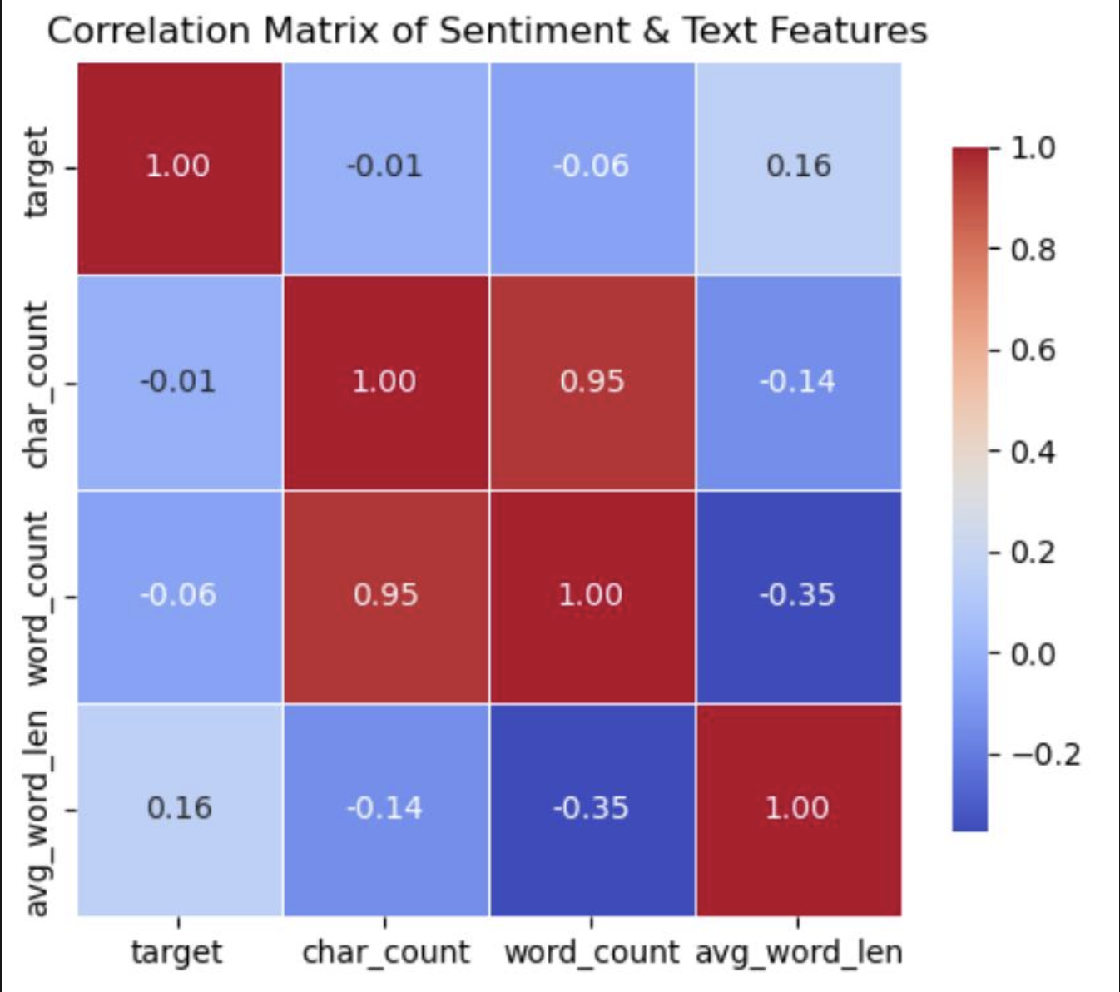

Slide 14
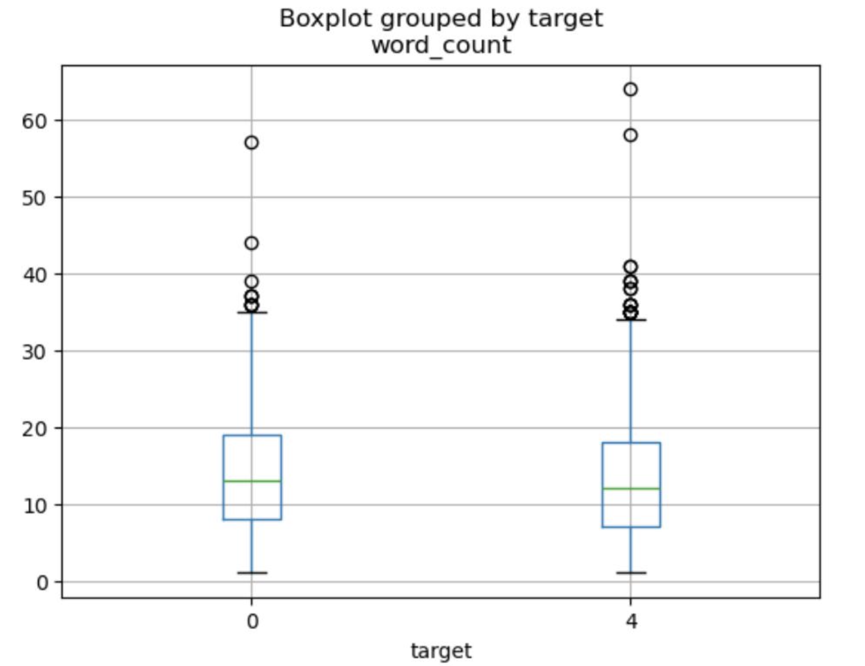
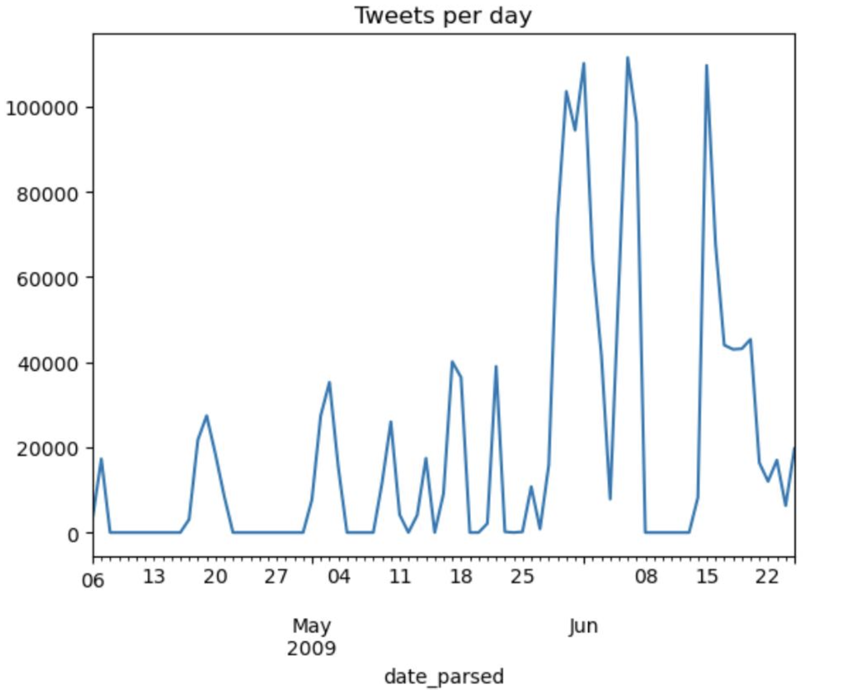
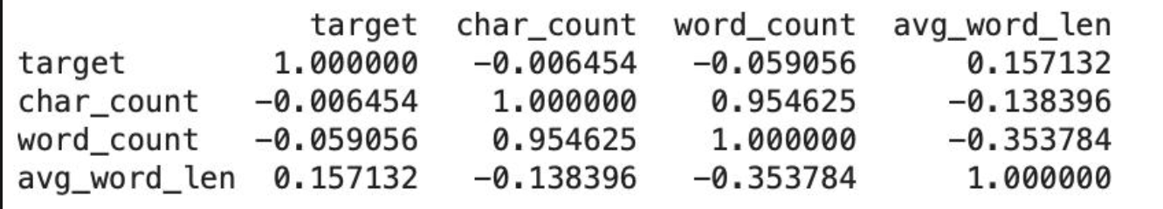

Slide 15
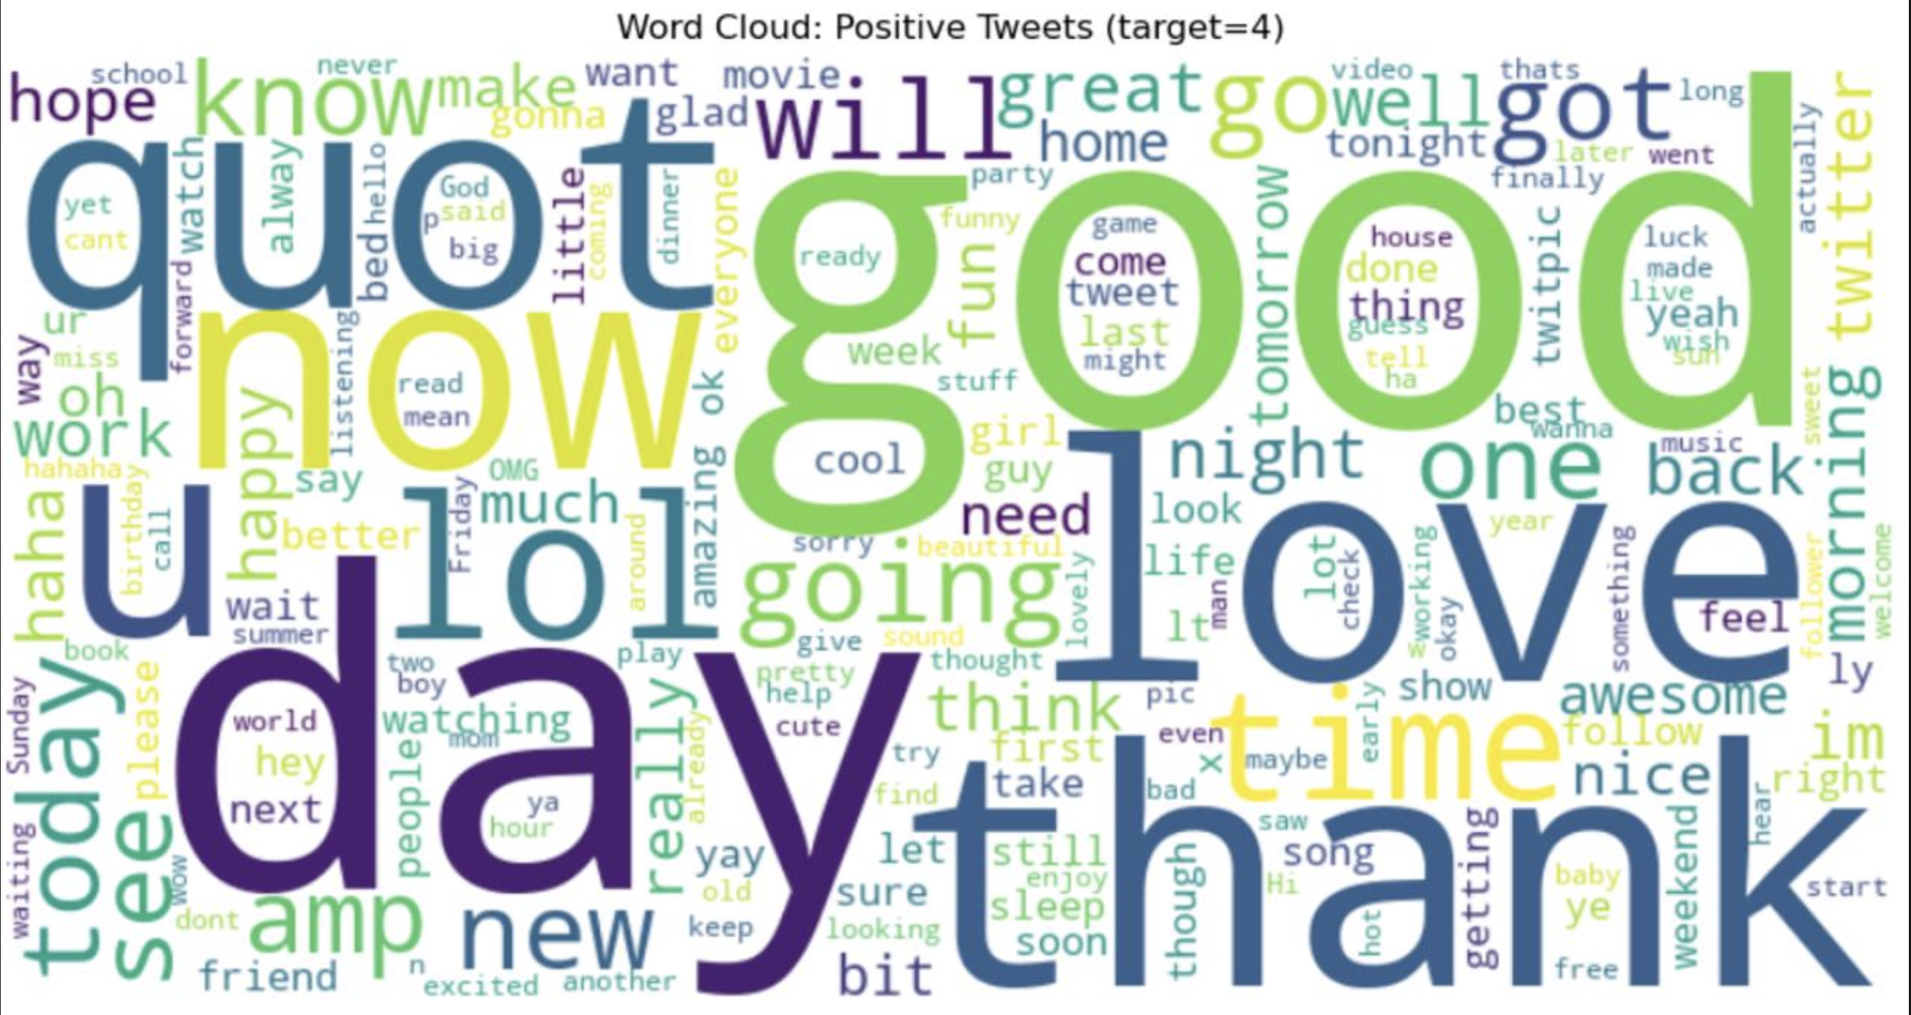

Slide 16
Data Preparation
05

Slide 17
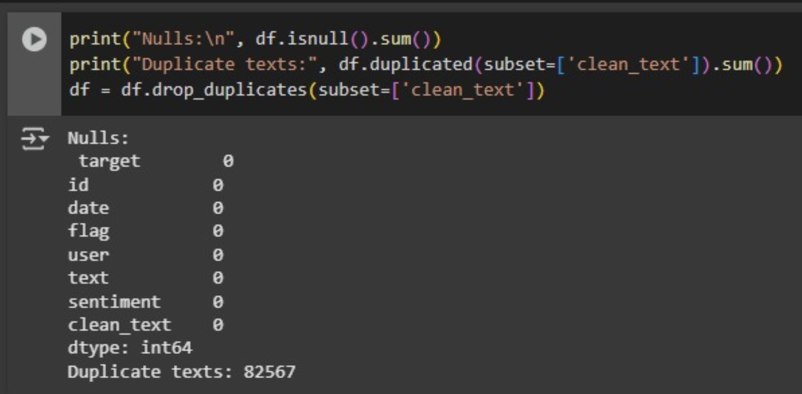

Slide 18
Feature Engineering
06

Slide 19
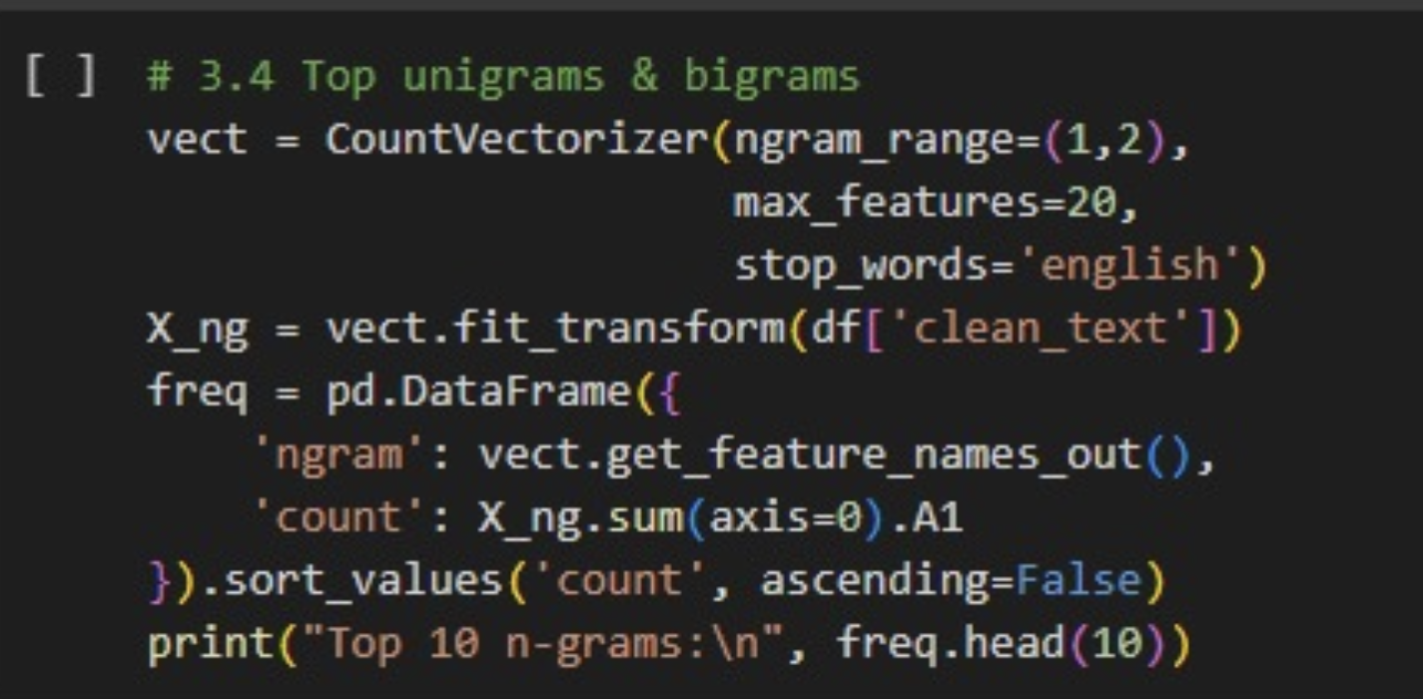
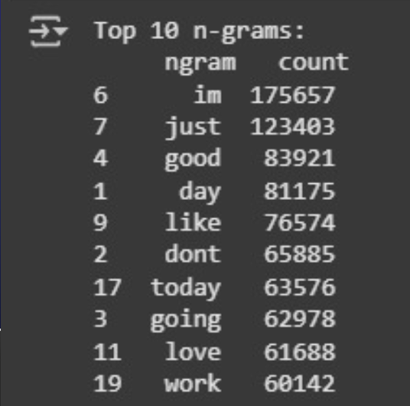

Slide 20
ABT Table
07

Slide 21
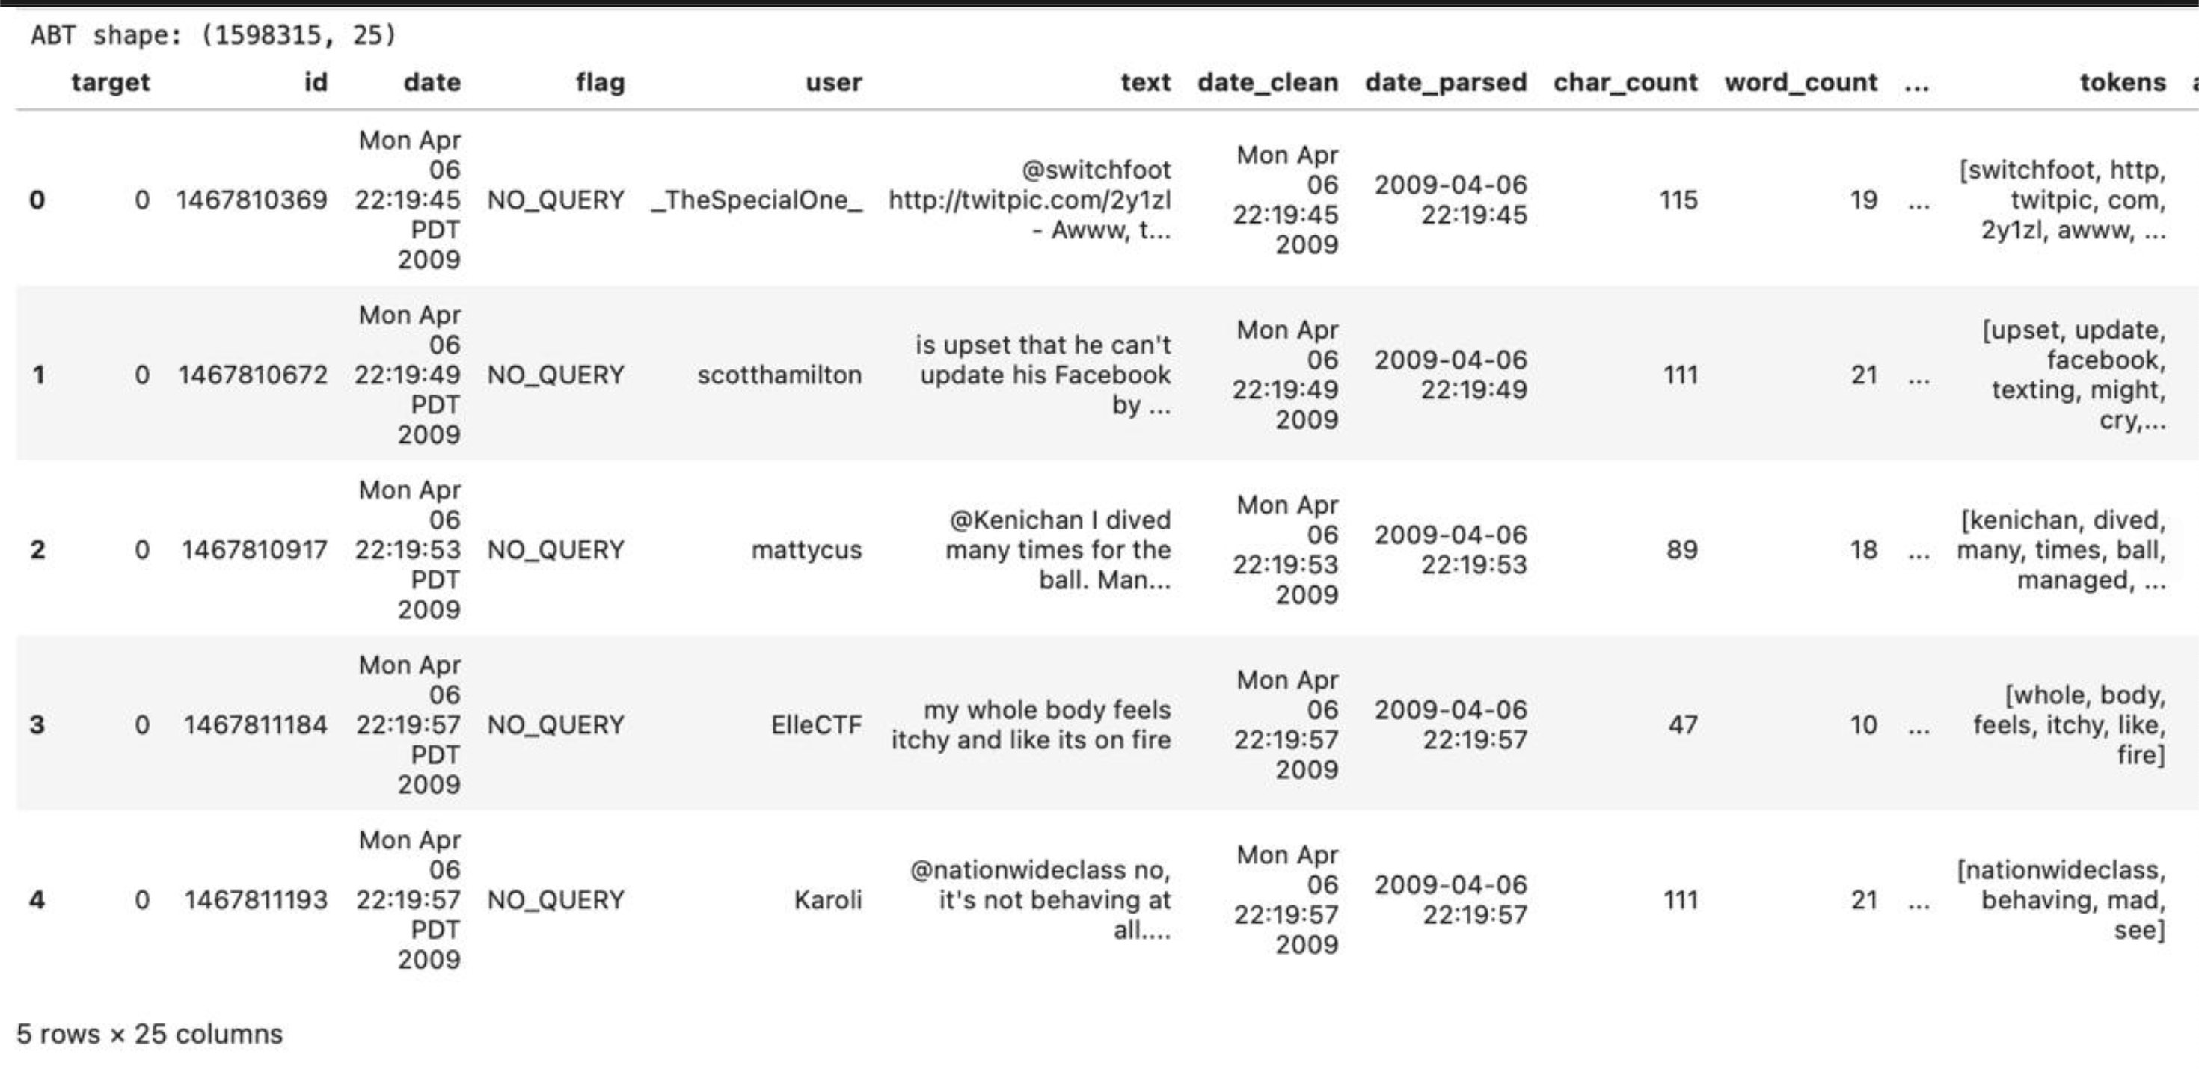
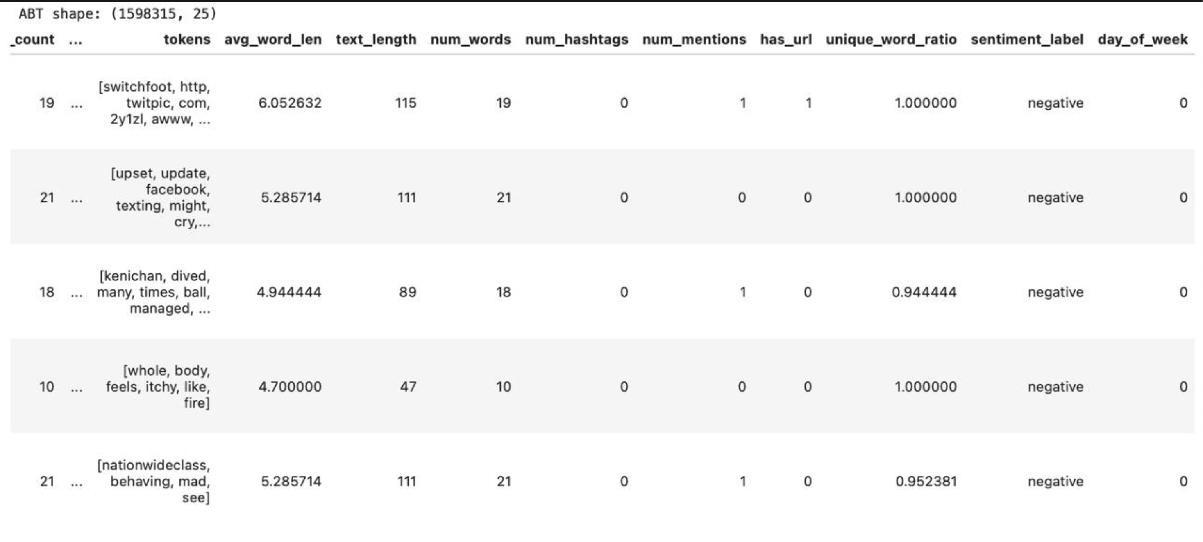

Slide 22
Modeling Practices and Algorithms
08

Slide 23
Data Preprocessing Techniques
Missing value handling
Categorical variable encoding (if applicable)
Feature scaling for traditional models
Feature engineering
Tokenized text data
Removed stop words and special characters
Applied vectorization (TF-IDF for SVM and Logistic Regression)
Logistic Regression
Simple and interpretable baseline
Effective for linearly separable text data
Outputs probabilistic predictions
Support Vector Machine (SVM)
Strong performance with high-dimensional sparse data
Effective in binary classification
Used decision function for confidence scoring when predict_proba not available
Optimization
Used GridSearchCV for tuning SVM and Logistic Regression hyperparameters
BERT fine-tuned with learning rate and batch size experiments
Confidence scores displayed to indicate prediction certainty
BERT (Transformer-based)
Context-aware word embeddings
Fine-tuned for sequence classification
Robust at capturing semantic nuances in tweets

Slide 24
ROC Comparison
09

Slide 25
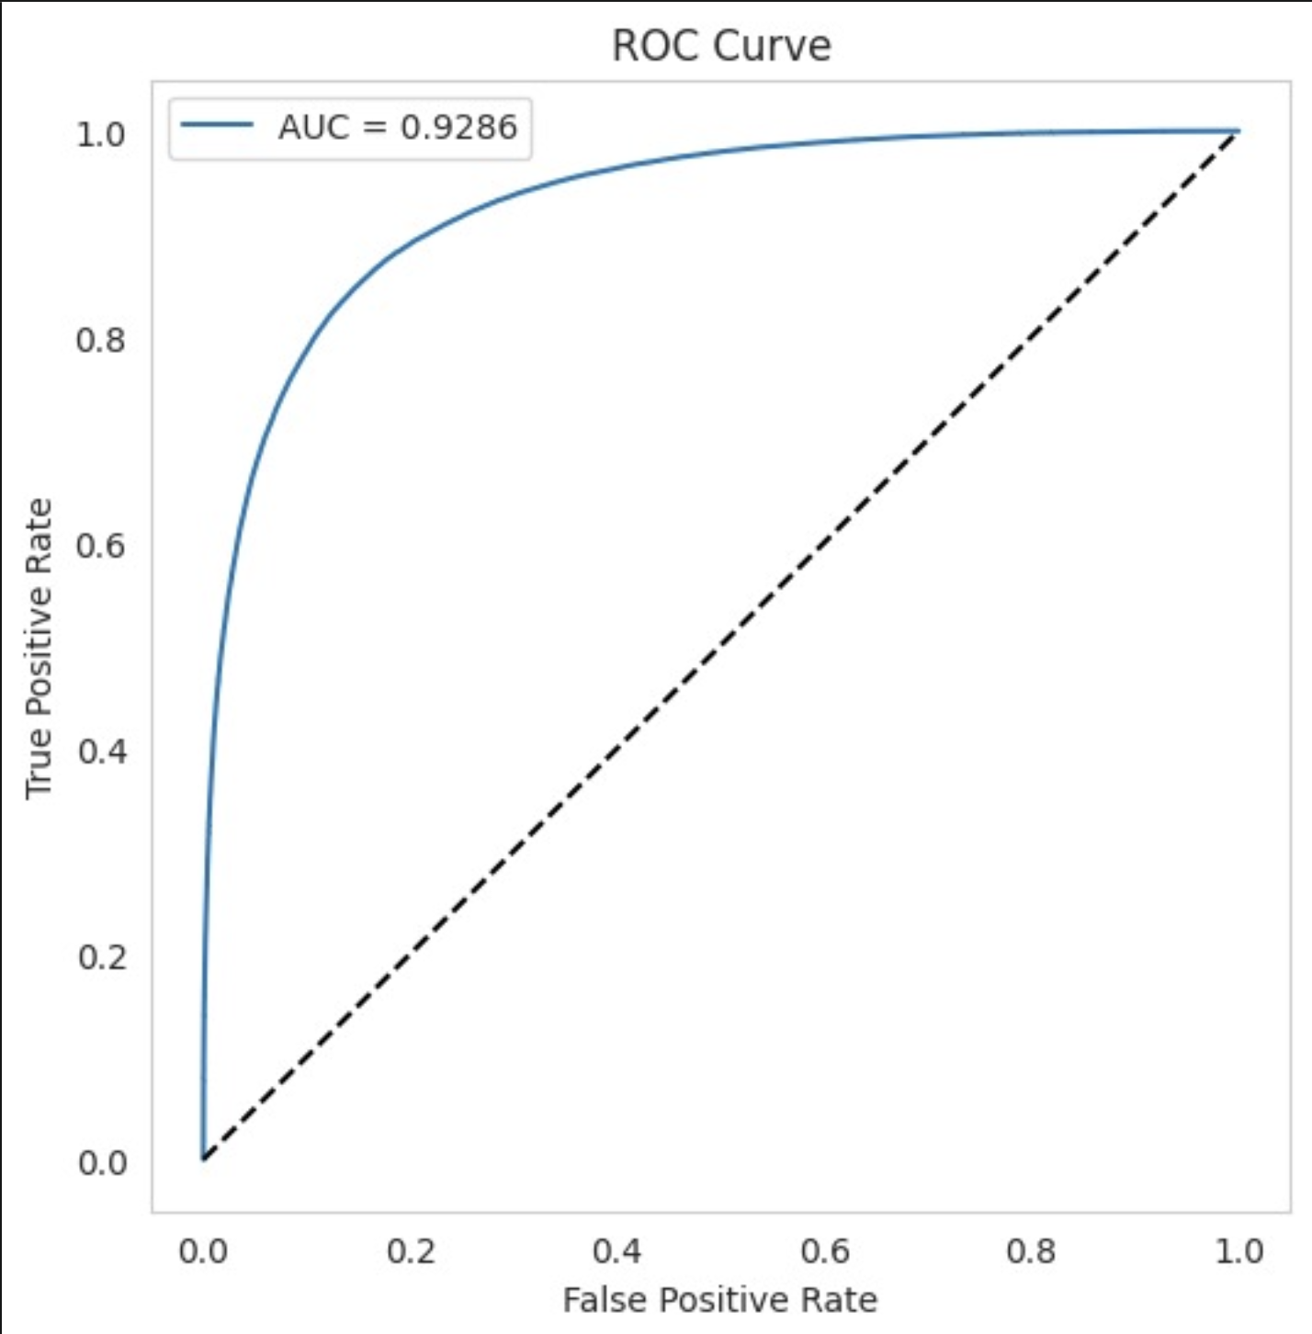
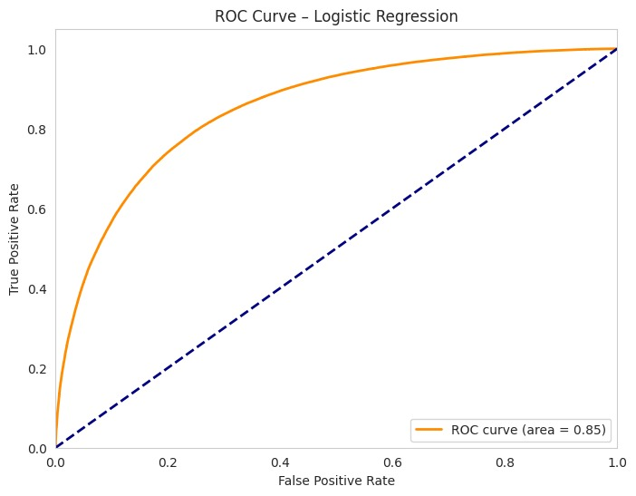
High Model Performance: The Area Under the Curve (AUC) is 0.9286, which indicates that the model has excellent discriminatory ability between the positive and negative classes. Low False Positive Rate: The ROC curve rises sharply towards the top-left corner, suggesting the model achieves a high true positive rate while maintaining a low false positive rate.
Moderate Model Performance:
The Area Under the Curve (AUC) is 0.85, indicating that the model has a reasonable ability to distinguish between positive and negative classes, but falls short compared to deeper models like BERT.
Higher False Positive Rate:
The ROC curve shows a slower rise, suggesting the model is more prone to false positives and may miss subtle sentiment cues present in more complex text.

Slide 26
Cofusion Matrix
10

Slide 27
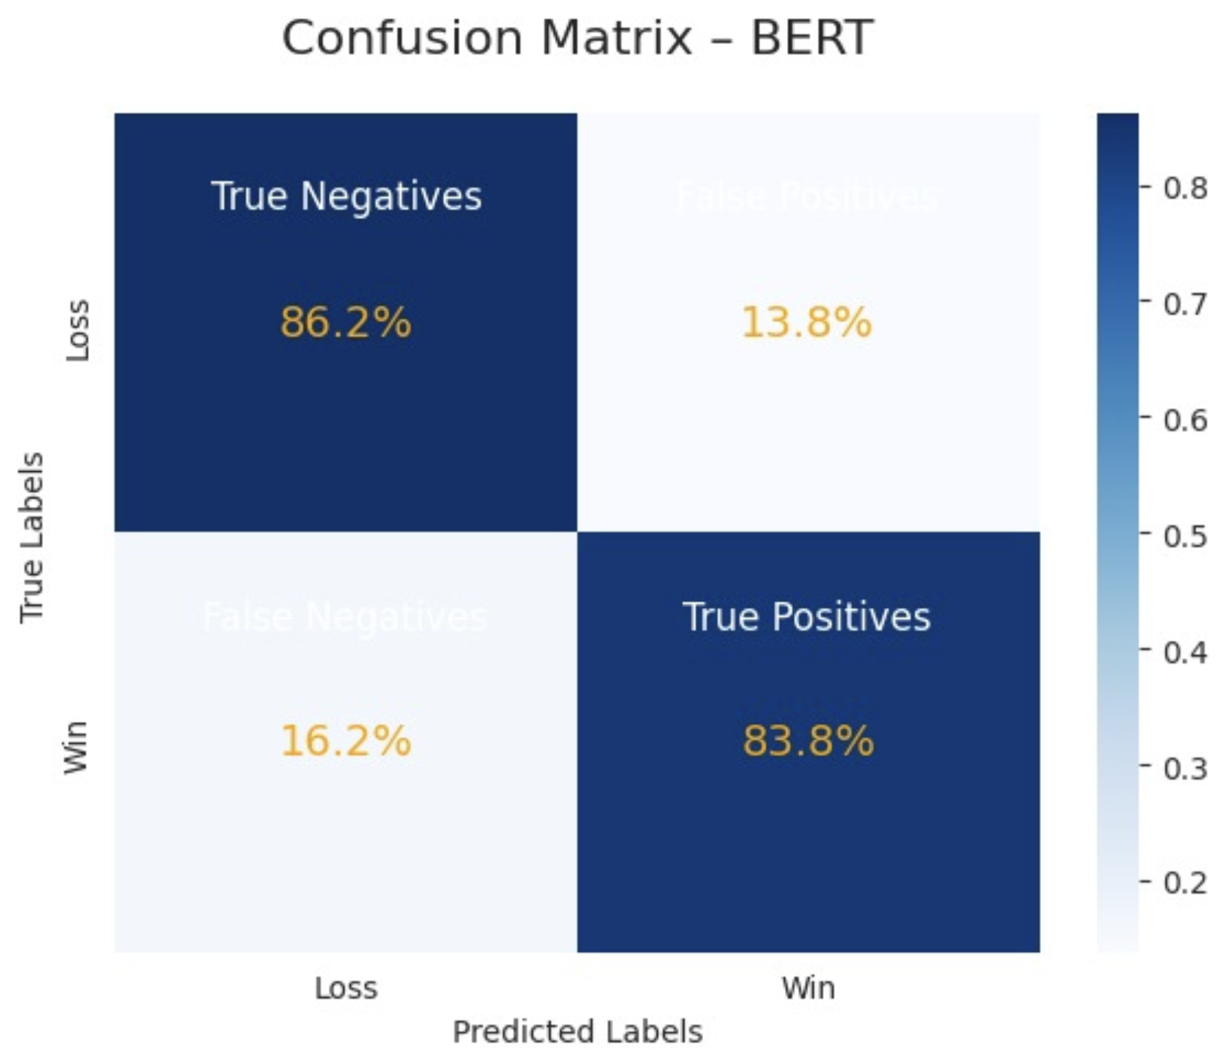
High Overall Accuracy: The model correctly classified 86.2% of the "Loss" cases and 83.8% of the "Win" cases, showing strong performance in both classes. Balanced Performance with Low Misclassification: The misclassification rates are relatively low — only 13.8% false positives and 16.2% false negatives — indicating good balance and minimal bias toward either class.

Slide 28
Model Performance Comparison
11

Slide 29
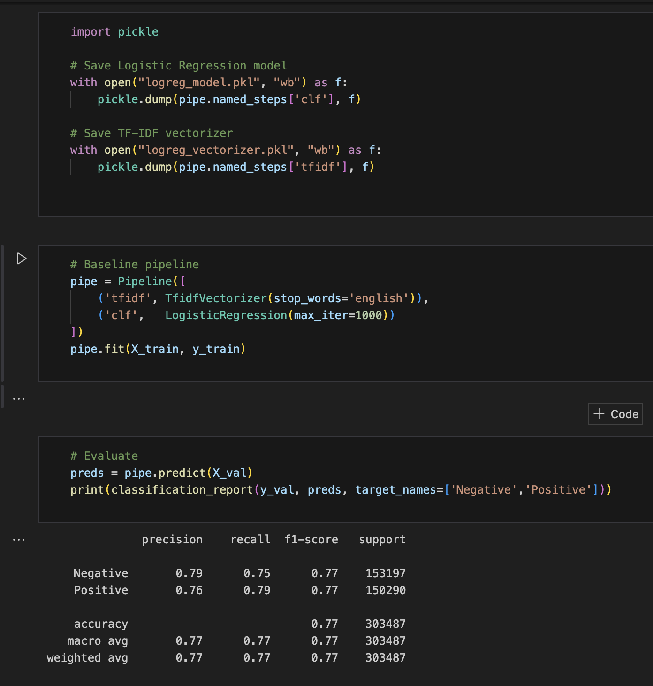
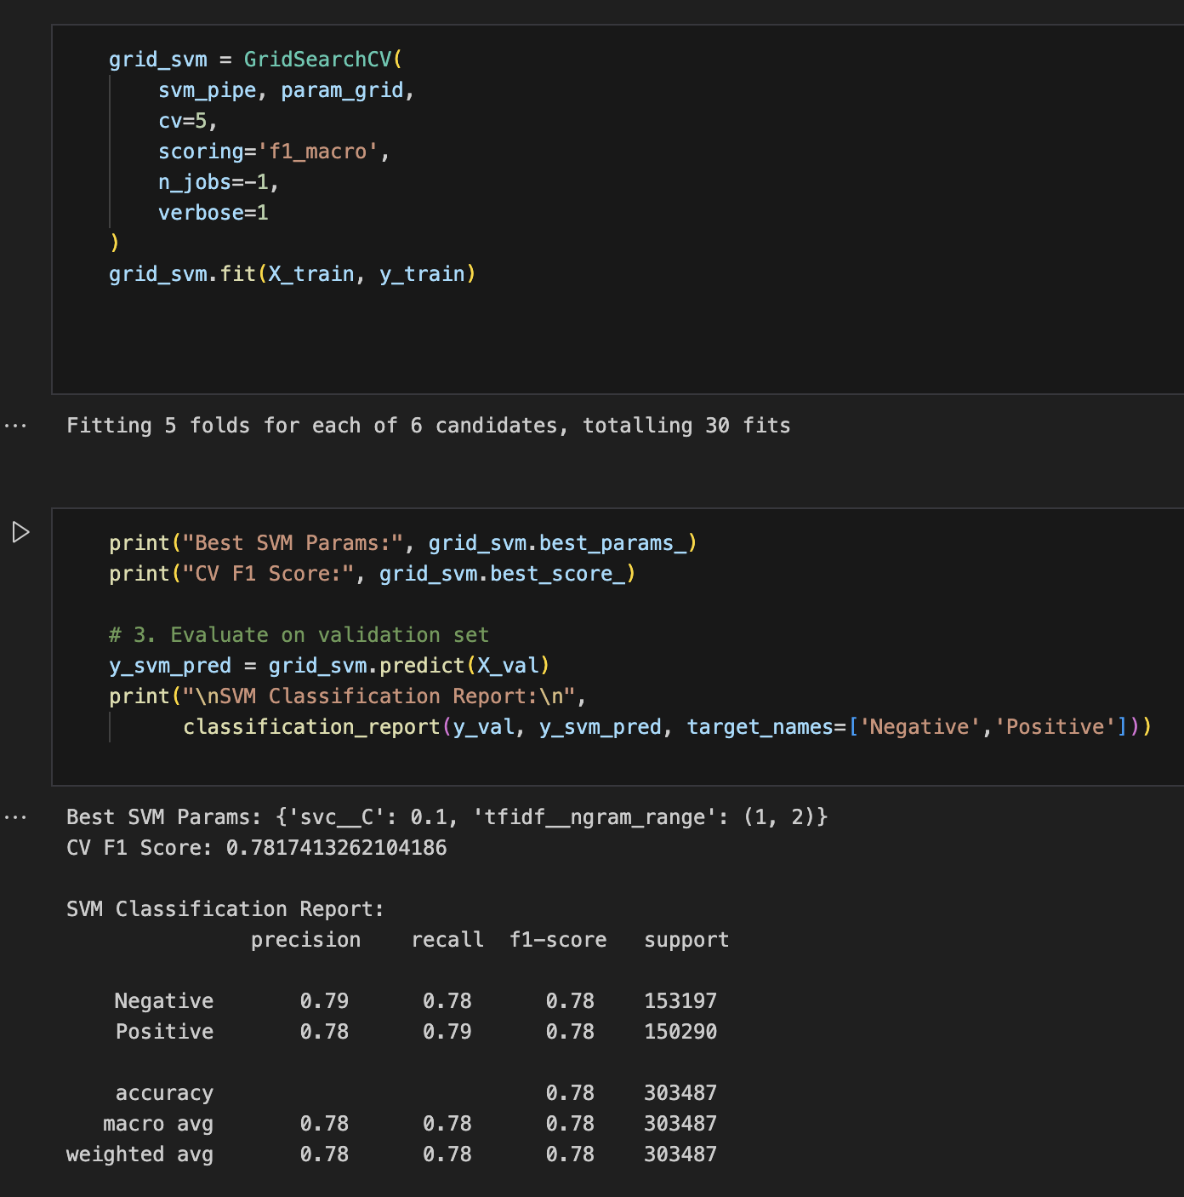

Slide 30
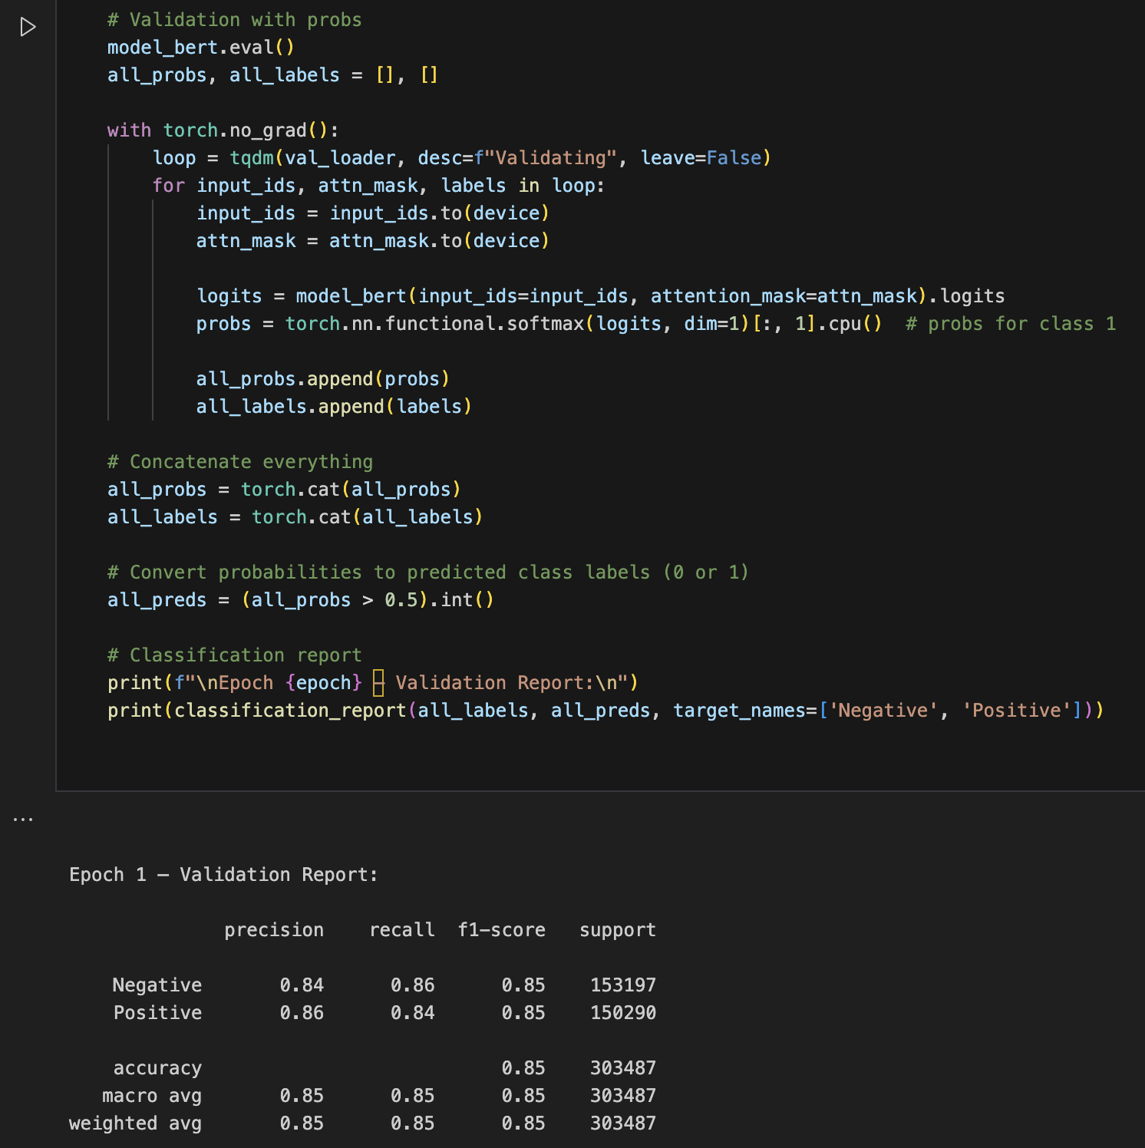

Slide 31
Model Insights & Conclusion
12

Slide 32
Logistic Regression: Macro F1-score = 0.77, showing a solid baseline with balanced performance.
SVM (GridSearchCV): Improved slightly with a macro F1-score = 0.78, indicating that tuning helped enhance performance.
BERT (Fine-tuned): Outperformed both traditional models with a macro F1-score = 0.85, highlighting its superior ability to understand language context and semantics.
Model Performance Comparison
Class Wise Behavior
All models maintain balanced precision and recall across both classes (Negative and Positive), but BERT has the highest recall for both (0.86 for Negative and 0.84 for Positive), meaning it’s best at capturing all relevant samples.
Support Consistency
The dataset is large and well-balanced (~150k+ samples/class), which ensures a fair evaluation and reflects that improvements are not due to data skew.

Slide 33
Conclusion
BERT clearly outperforms both Logistic Regression and SVM in terms of precision, recall, and F1-score, making it the most suitable model for this classification task.
While traditional models are faster to train and simpler to deploy, deep learning models like BERT provide significant gains in accuracy and are ideal when computational resources allow.
For production deployment, Logistic Regression may still be viable for low-latency or resource-constrained environments, but BERT is recommended when prediction quality is critical.

Slide 34
Deployment
13

Slide 35
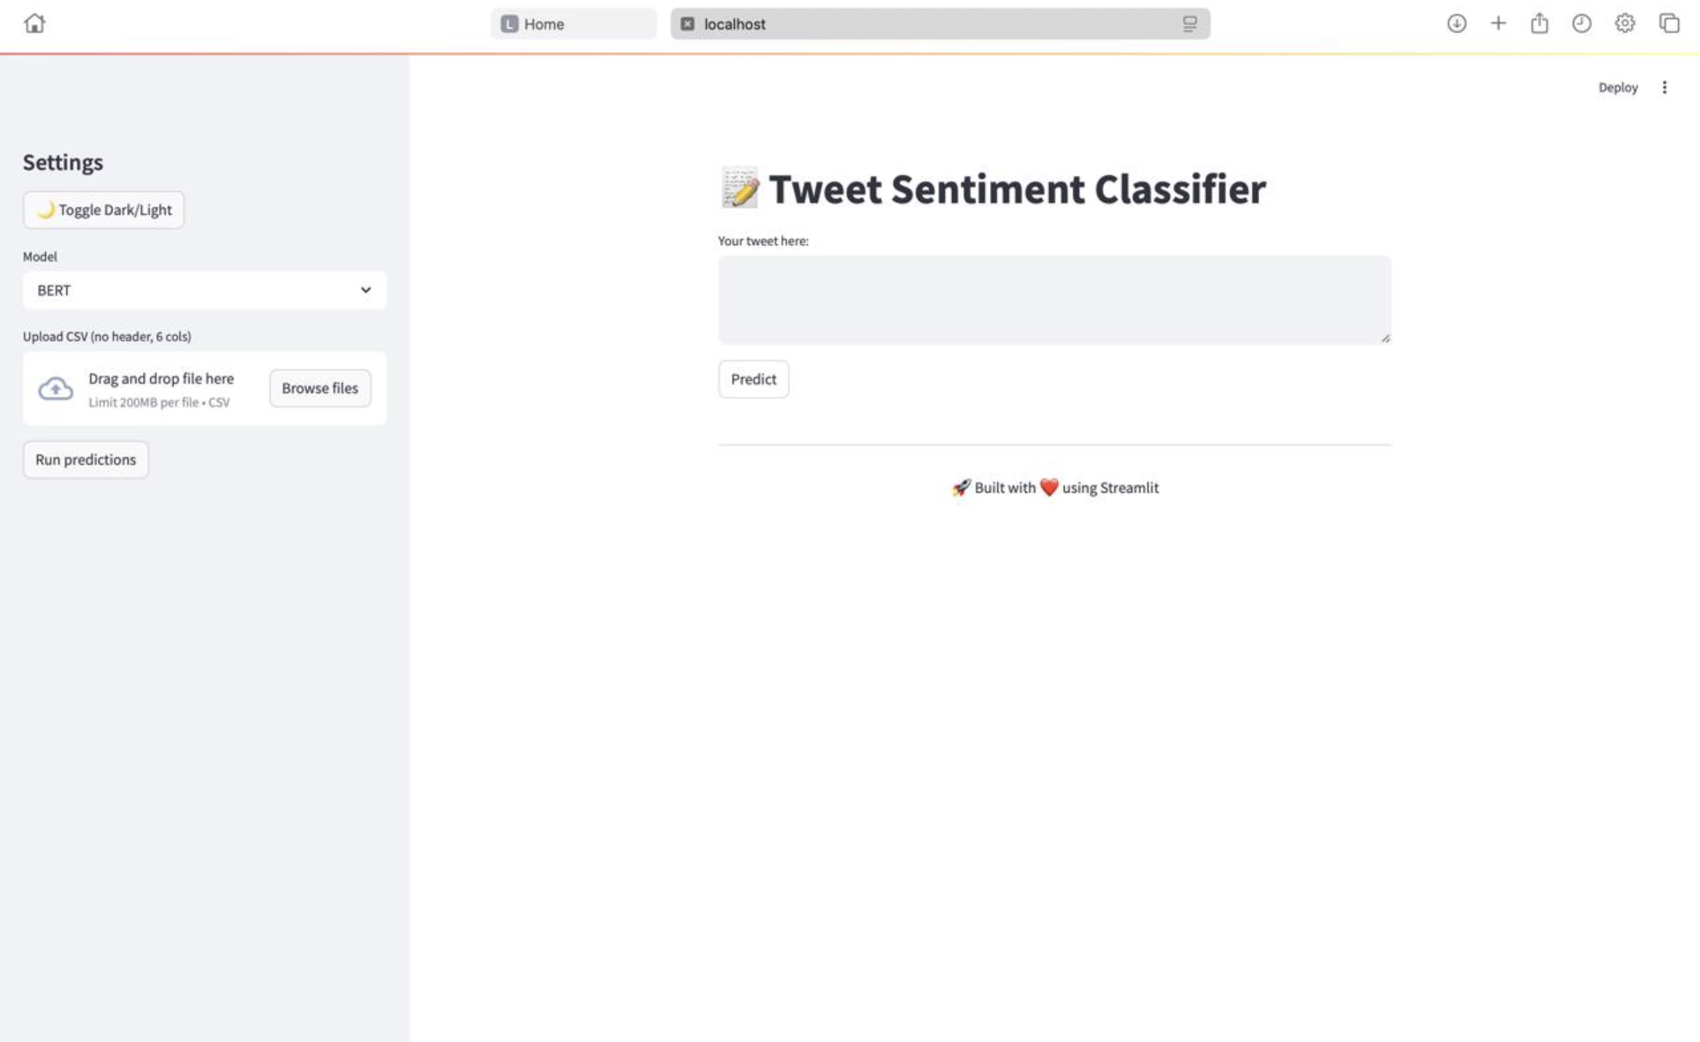
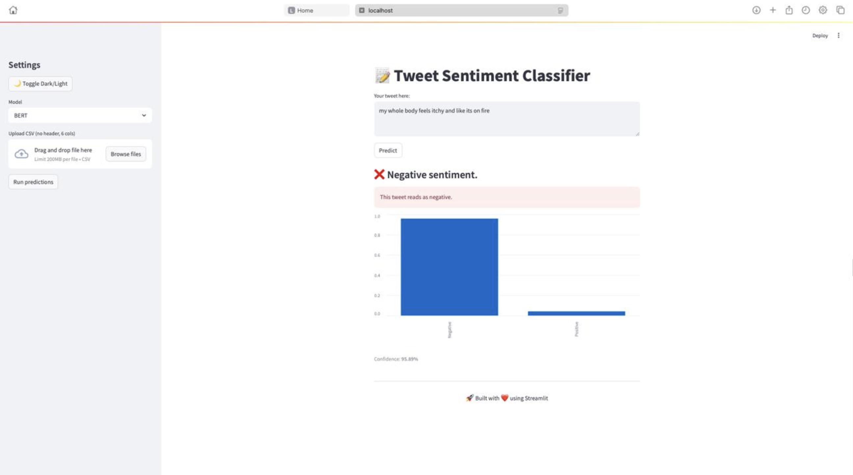

Slide 36
Project Overview
14

Slide 37
Project Objective
Classify tweet sentiment as Positive or Negative
Compare traditional ML and deep learning models
Build an interactive and user-friendly prediction tool
Key Accomplishments
1. Data Preparation
Pre-processed tweets: cleaned text, removed stop words, tokenized
Applied TF-IDF vectorization for classical models
2. Model Training
Trained Logistic Regression, SVM, and fine-tuned BERT
Integrated model confidence scoring and fallback logic
3. User Interface
Streamlit-based Web Interface with theme toggle
Live model switching and sentiment visualization

Slide 38
Future Works
15

Slide 39
Temporal Sentiment Trends
Incorporate time-based analysis to identify evolving sentiment trends, seasonal patterns, and event-driven changes.
Model Optimization
Explore faster and lighter models like DistilBERT for better efficiency without compromising performance.
Sarcasm & Irony Detection
Investigate methods to handle sarcastic and ironic expressions which are often misclassified in sentiment analysis.
Improved Preprocessing
Enhance robustness to noisy inputs (slang, emojis, misspellings, abbreviations) to better handle informal and user-generated content.
Domain-Specific Adaptation
Fine-tune models for specific domains (e.g., finance, politics, health) to boost accuracy and contextual understanding.
Multilingual Support
Expand the model to handle tweets in multiple languages to improve accessibility and global relevance.

Slide 40
Q&A

Slide 41
Thank You

Slide 42
Table of contents
01
Problems & Formulations
06
Data Preparation
02
Proposed Solution
07
Feature Engineering
03
Data & Formulation
08
ABT Table
04
Data & Features
09
Final Data Preprocessing for Model Building
05
Data Understanding and Exploration
10
Model Assumptions

Slide 43
Table of contents
11
Modeling Practices and Algorithms
16
Model Insights & Conclusion
12
ROC Comparison
17
Deployment
13
Confusion Matrix Compression
18
Project Overview
14
Model Performance Comparison
19
Challenges & Future Directions
15
UI Images

Slide 44
Data Preparation
07

Slide 46
Final Data Preprocessing for Model Building
10

Slide 48
UI Images
15

